Slide 1
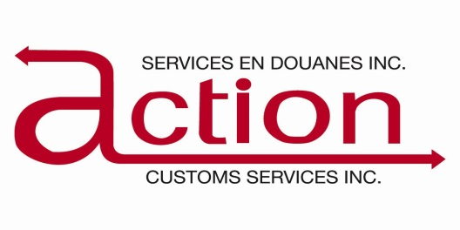
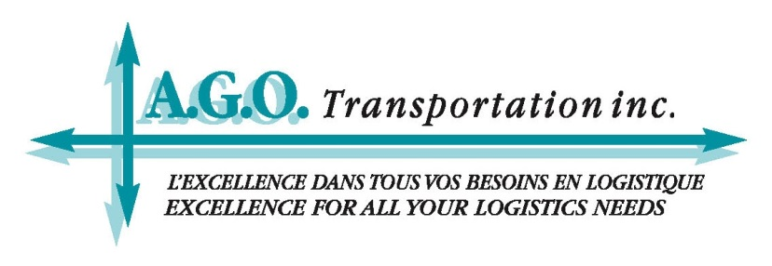

Slide 2
Non-Resident Importing into Canada

Slide 3
What Does This Mean for You?
Canada’s importers have much more buying power and are realizing something that foreign companies have been implementing for many years
They are now requesting/requiring that their goods be delivered to their door duties, taxes and transportation included.
They want a more seamless and hassle free transaction

Slide 4
Advantages for You
Increased market share by making it simpler and easier for Canadian clients to buy from your clients and perhaps handling the freight and customs from A to Z
Enhancing their customer experience with you thereby increasing the chance of customer loyalty and retention
You have increased control over your sales, profits and expenses

Slide 5
What Makes it SO Complicated?
The GST and HST Taxes!

Slide 6
What is GST/HST?
GST (Goods and Services Tax) is a 5% tax assessed on most goods and services in Canada including all imports
It is payable at time of importation
Non taxable goods are referred to as zero-rated supplies ex: basic groceries, prescription drugs, International Freight & Transportation Services and Canadian Goods Returned

Slide 7
What is HST?
HST stands for Harmonized Sales Tax
It is part of the GST Tax System and is administered through the CRA (Canada Revenue Agency).
It only applies to sales in certain provinces across Canada
Ontario – 13%
Atlantic Provinces (New Brunswick, Prince Edward Island, Newfoundland, & Labrador) – 15%

Slide 8
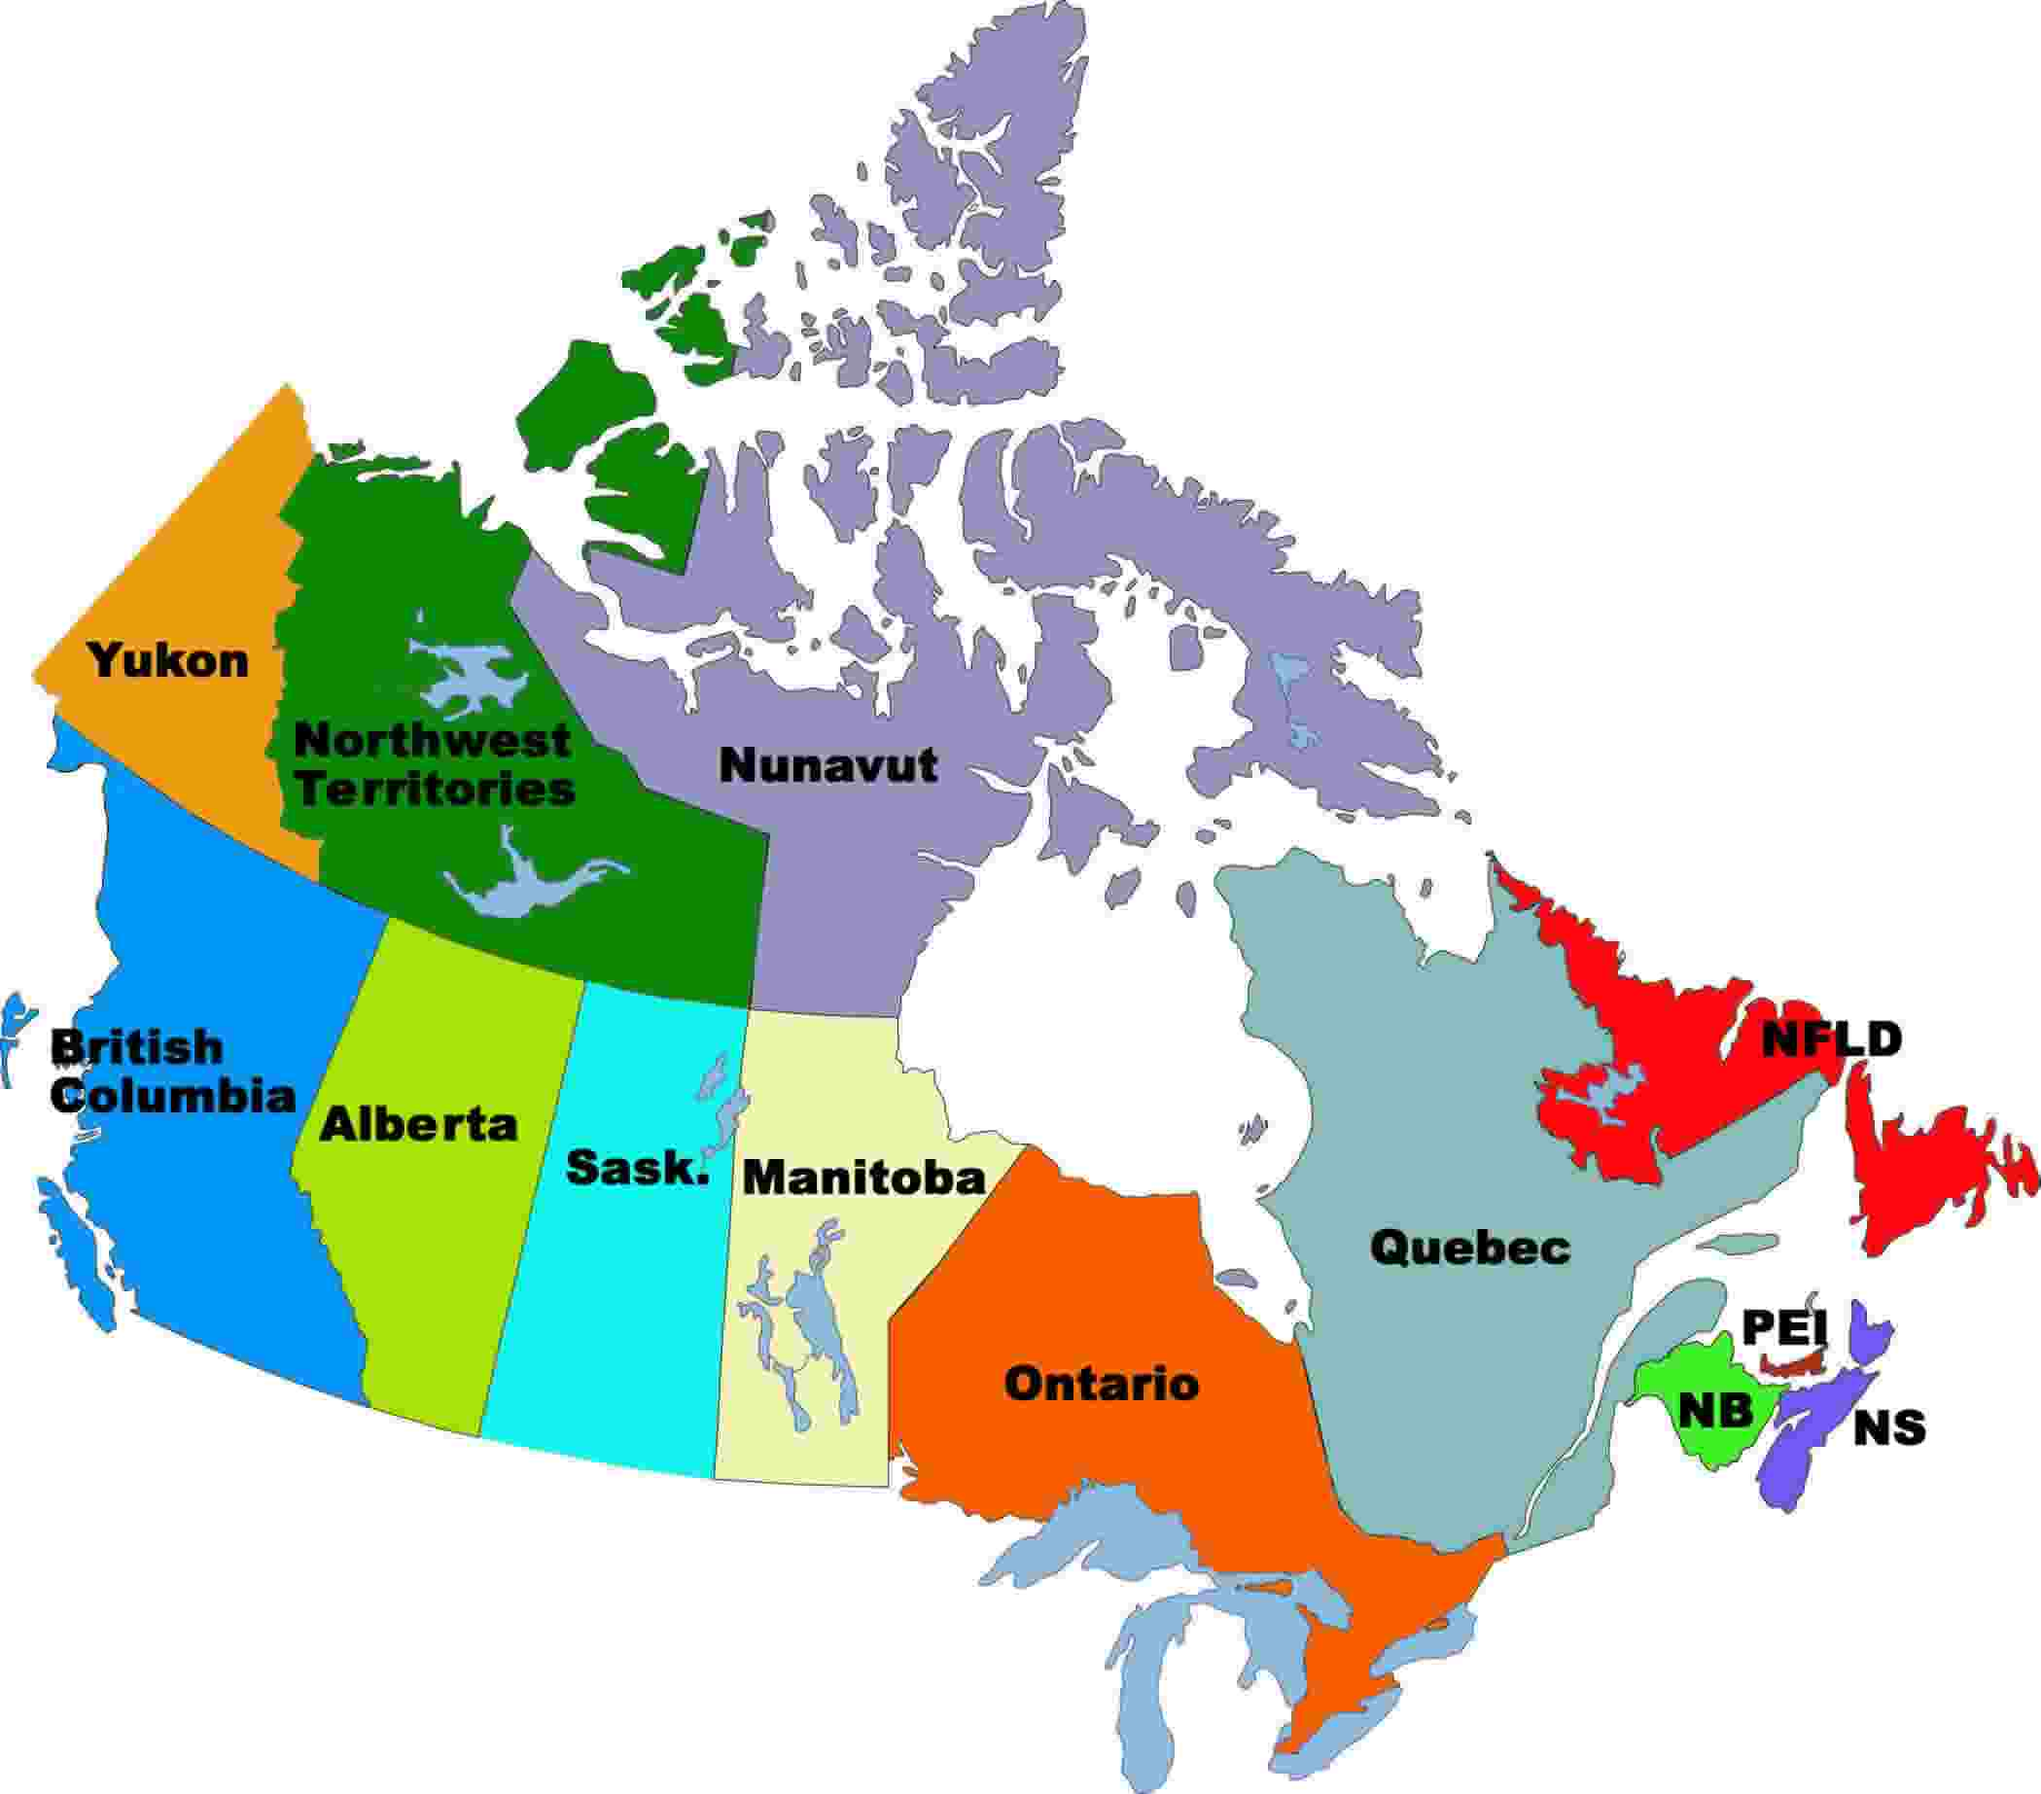
Canada

Slide 9
The Most Important Questions to ask
Who will be the Importer of Record?
What is your anticipated volume
(# of shipments into Canada) ?
What are your terms of sale (incoterms)?

Slide 10
Should Your Client Register?
Most companies who chose to be NRI will choose to voluntarily register for GST/HST and fall into the category of carrying on business outside Canada since they regularly solicit orders for goods to be exported or delivered to Canada on a delivered duty paid basis

Slide 11
Should your client Register?
If your client anticipates having more than 2 shipments into Canada where the Foreign Company is acting as the Importer of Record, you should have them register
If they do NOT register, they cannot charge the GST, they cannot collect the GST, but they still have to pay the GST upon importation

Slide 12
How does the GST work?
Like the European VAT
Can be claimed back by the Canadian Importer or Non Resident Importer providing they are registered for GST with Revenue Canada.
Non Resident importers must charge their Canadian customer the GST/HST depending on what province they are selling to
The GST/HST must be shown as a separate line on the commercial invoice
ONLY the GST is paid to customs when the goods are imported
You will receive a form from the CRA where you will indicate all the GST you paid (input tax credit) to Customs on import versus all the GST/HST you collected from your clients (plus/minus)
This amount will result in either a remittance to the Government or a refund
You can choose to file your GST/HST monthly, quarterly or yearly depending on the disbursements involved. Most companies chose quarterly reports.

Slide 13
Benefits
The foreign importer gets the 5% GST that they paid on import refunded to them
They can also get back any GST paid for goods that were exported back into the country from which they were imported. (for example replacement, damaged, rejected).

Slide 14
Obligations
The NRI must establish an accounting system to:
Identify all the taxes they collected on sales
Identify all taxes they paid (called an Input Tax Credit).
They will need to provide Customs with a security deposit of $5000.00 minimum or a surety bond (Cost is approximately $500.00 per year).
Must remain registered for the GST for at least 1 year

Slide 15
Obligations
Must maintain books and records in Canada for 6 years
Non-Residents can request permission to maintain books and records outside Canada by filling out a request form
Canadian Customs Brokers can also remit GST returns on behalf of their clients as well as maintain their books & records

Slide 16
How to Register
Fill out an application (RC1) to request a GST/Business number.
Usually takes about 3 to 4 weeks to get a GST Number back, however the NRI is eligible to start claiming back any GST they paid the minute Revenue Canada receives their application
Any GST they have paid before sending that application to Revenue Canada cannot be claimed back retroactively, so it is important to make sure to apply before your 1st importation into Canada

Slide 17
GST/Business Number
Once the NRI receives this number, it will serve as an identification number for the company with Revenue Canada (like your U.S. IRS# or European VAT #)
It will also serve as an Importer Number (application must be made)
You will also need a Customs Bond for duties and taxes which costs $500.00.

Slide 18
How do I Simplify the Process?
The entire registration process from A to Z can be taken care of by a Canadian Customs Broker providing they are familiar with the rules and regulations pertaining to Non-Resident Importers
Example of client who lost $30,000.00 because the broker did not register them
In any case if your client decides to be the Importer of Record, they will need a Canadian Customs Broker and they will need a Canadian Power of Attorney signed by an officer of the Company

Slide 19
Scenario 1
Foreign vendor sells to a company in Canada where that Canadian company acts as the Importer of Record however the goods are drop-shipped from another country to Canada
Canadian importer is responsible for customs clearance, duties and taxes
Commercial Invoice or Canada Customs Invoice is required
(the 1st sale rule does not apply in Canada, has to be the invoice of sale between the US Company and the Canadian Company).
NAFTA is not applicable unless the goods are coming from Mexico however other tariff treatments may be applicable according to agreements with other countries
(ex: GPT – China, LDDC – Bangladesh…).

Slide 20
Scenario 2
Foreign Company planning to act as the Importer of Record once or twice
No need for Foreign Company to register for GST
Use the flow through method where they are allowed to charge their Canadian client the GST of 5% and the Canadian client can use the B3 (7501) as proof to claim back their GST from the Canadian Government
In addition, a Canadian POA is required (signed by officer)
All the requirements mentioned in Scenario 1 will be applicable
Full legal company name, address, telephone number and name of the President of the Company will be required
Once that is done, we can apply for an Importer Number on behalf of the client
*Note: an Importer Number and GST Number are not the same thing

Slide 21
Ways of Dealing with GST in this Case
Send the shipment DDP excluding GST which will be for the account of the consignee
Have the Customs Broker bill everything back to the agent except for the GST which the Canadian Broker will bill to the Consignee in Canada

Slide 22
Things to Remember
1. LVS SHIPMENTS:
Low Value Shipments are defined as any shipment that is under $2500.00 CAD and come in by Fed Ex, UPS or DHL and are approved by customs to pass under the LVS system
Shipments subject to OGD’s or paperwork that reads “Value for Customs $1.00” will usually get refused on the LVS system
Shipments are delivered to client prior to the broker doing any paperwork for Customs
Rules different than the USA

Slide 23
Things to Remember
2. Importer Numbers:
Customers using their Importer Number for the 1st time will automatically get referred for exam at least for the 1st shipment if not the 1st few shipments which can lead to expensive examination charges in some cases.
3. Compliance:
When you become the Importer of Record it automatically transfers any and all responsibility for the import to your company in the eyes of Canada Customs; for example tariff classification, origin, tariff treatment….

Slide 24
Things to Remember
4. End Use:
We have annex codes or certain classification codes based on end use that reduce or remove the customs duty on certain items so where applicable, it’s important to ask the client. ex: all fabric for use in the manufacture of clothing is now duty free from all Countries
5. Valuation:
The commercial invoice must reflect the true selling price between the Vendor and the client in Canada
If there is no sale price prior to the shipment leaving for Canada, you can use the 1st sale rule but only if the goods are shipped directly from their point of loading and have not cleared U.S Customs.

Slide 25
Things to Remember
6. Payment of Duties & Taxes:
An NRI obtains an annual bond approved by Canadian Customs which allows them to pay all duties and taxes owing once a month
It is very practical because the importer has no credit limit as far as duties and taxes are concerned, and they make only 2 checks per month. (one to the Receiver General and one to the Customs Broker)

Slide 26
Things to Remember
7. Permits:
Some goods will require Import Permits ex: steel
8. Prohibited Items:
Ostrich or Peacock feathers (tariff code 9897.00.00.00)
9. Anti Dumping or Countervailing Duties:
Bicycles and their parts from China

Slide 27
Things to Remember
10. OGD’s
C.F.I.A.
NrCan
Health Canada
Transport Canada
Consumer Products Safety
If the goods are subject to any of these departments, certain additional information or documentation may be required by Customs

Slide 28
Things to Remember
11. Consumer Packaging & Labelling Requirements:
Similar to other countries but should always check to be sure
Bilingual Labelling
Clothing and certain types of upholstered furniture require a CA Number (Equivalent to a U.S RN Number) which is regulated by Industry Canada

Slide 29
Things to Remember
12. Alcohol & Tobacco:
Hefty taxes
Alcohol needs an import permit from the Provincial Liquor Board of the Province you are importing it into.
Rule of thumb, take the VFD and multiply by 2

Slide 30
Conclusion
Do not sell or ship to Canada
prior to consulting with a specialist beforehand
or you may end up with an
expensive and unwanted surprise

Slide 31
Useful Resources
GST/HST Information for Non-Residents:
http://www.cra-arc.gc.ca/tx/bsnss/tpcs/gst-tps/rgstrng/menu-eng.html
Register for a GST/HST account:
http://www.cra-arc.gc.ca/tx/bsnss/tpcs/gst-tps/rgstrng/menu-eng.html

Slide 32
Canadian Government Links
Industry Canada
www.strategis.is.gc.ca/intro.html
Health Canada
www.hc-sc.gc.ca
Natural Resources Canada
www.nrcan.gc.ca
Transport Canada
www.tc.gc.ca
Canada Border Services Agency
www.cbsa-asfc.gc.ca
Canada Customs Tariff Online
www.cbsa.gc.ca/trade-commerce/tariff-tarif/
Canadian Food Inspection Agency
www.inspection.gc.ca
Dept of Foreign Affairs
www.dfait-maeci.gc.ca

Slide 33
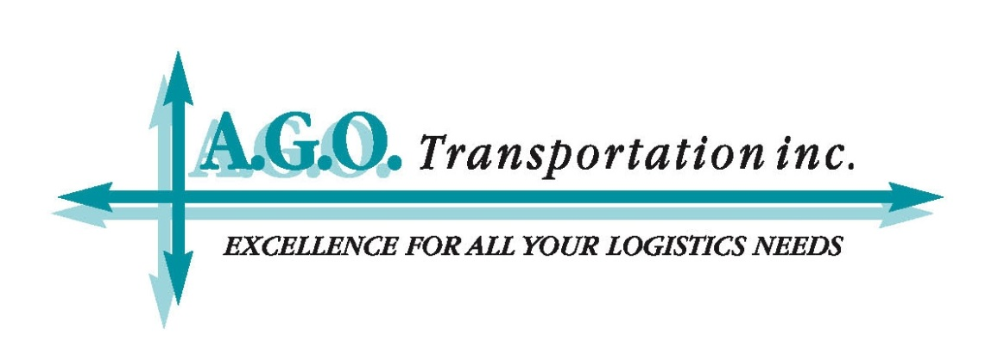
Questions
Sandra Faraj
Vice President
A.G.O. Transportation
sfaraj@agotrans.com
T: 514.631.6663
André Goguen
President
A.G.O. Transportation
agoguen@agotrans.com
T: 514.631.6663
www.actionago.com

